Slide 1

1. Introduction to Marketing Research
Frank (Yufan) Lin

Slide 2
What we talked about last time?
Purpose of Marketing Research
4 Steps of Marketing Research

Slide 3
Today’s Agenda
Use of Marketing Research
Going through the first three steps of marketing research process (of 11 steps)
Step 1- Establishing the need for Marketing Research
Step 2- Defining the Problem
Step 3-Establishing Research objectives

Slide 4
What are the uses of Marketing Research?
Identify marketing opportunities and problems
Generate, refine, and evaluate potential marketing actions
Monitor marketing performance
Improve marketing as a process

Slide 5
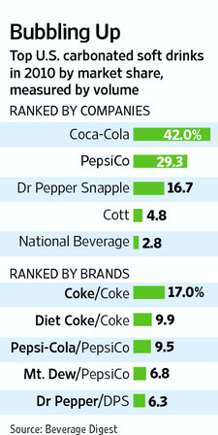
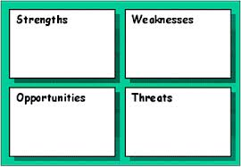
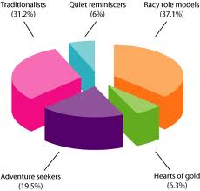
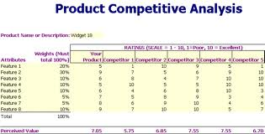
Identify Marketing opportunities and problems
Market Demand determination
SWOT Analysis
Market segment identification
Competitive Analysis
Notes:
Some marketing research studies are designed to fi nd out
what consumers’ problems are and to assess the suitability of diff erent proposed methods
of resolving those problems.
Managers are more likely to always know the symptoms (sales are down, market share is
falling), but determining the cause of the symptoms sometimes requires research.
Sales are down, but why? What causes it

Slide 6

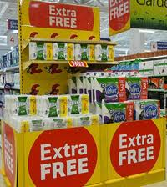
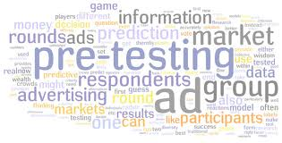
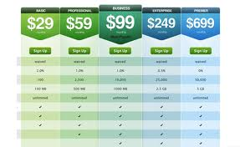
Generating, refining, and evaluating potential marketing actions
Prototype testing
In-store Promotion
Advertising pretesting
Pricing test
Notes:
We can think of “actions” as strategies, and strategies involve selecting a target market
and designing a marketing mix to satisfy the wants and needs of that target market.

Slide 7
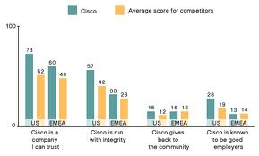
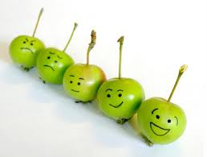


Monitoring marketing performance
Tracking studies
Employee Satisfaction
Customer Satisfaction
Pricing test
Notes:
monitor other variables such as their employees’ and customers’
satisfaction levels.
Competition
IRI monitor the performance of products in supermarkets and
other retail outlets. They track how many units of these products are sold, through which
chains, at what retail price, and so on.

Slide 8
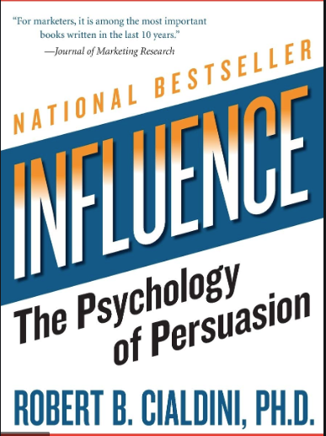
Improve Marketing as a Process
What are the most
important social
influence principles?

Slide 9


Slide 10
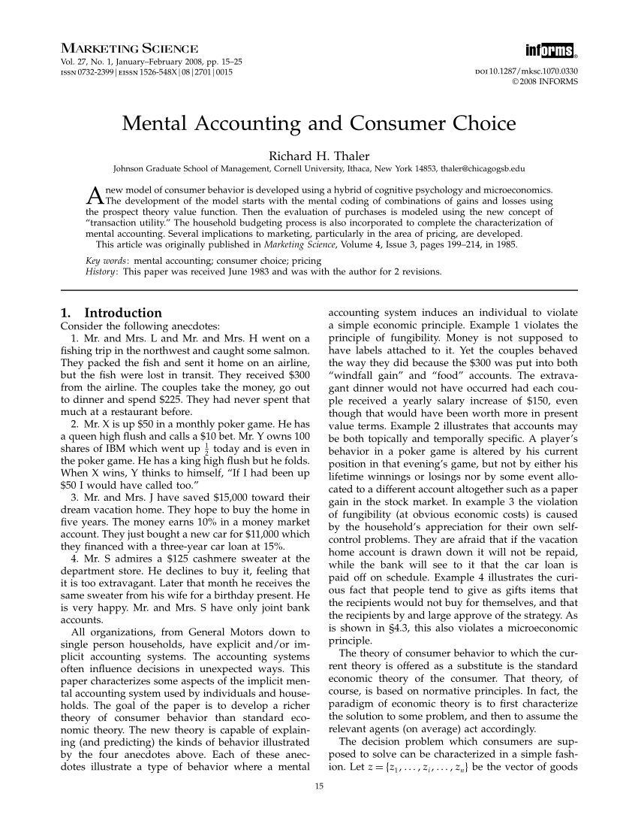
“Mr. S admires a $125 cashmere sweater at the department store. He declines to buy it, feeling that it is too extravagant. Later that month he receives the same sweater from his wife for a birthday present. He is very happy. Mr. and Mrs. S have only joint bank accounts”
Notes:
Who is Richard Thaler on Marketing Science?

Slide 11
Marketing Information System
Internal Reports System
Marketing Intelligence System
Marketing Decision Support System (DSS)
Guest Speaker
Marketing Research System
Notes:
A marketing decision
support system (DSS) is
defi ned as collected data
that may be accessed
and analyzed using tools
and techniques that assist
managers in decision
making.

Slide 12
Recap
Define Marketing Research
Purpose of Marketing Research
Marketing Research Problems
Function of Marketing Research
Marketing Information System
Assignment due soon: PA #1

Slide 13

2. Marketing Research Process
Frank (Yufan) Lin

Slide 14
Steps in the Marketing Research Process
Steps
Establish Need
Define Problem
Research Objectives
Determine Design
Identify Information Sources
Decide Data Collection Method
Design Questionnaire
Determine Sample Plan & Size
Collect Data
Analyze Data
Write and Present Report
Figure out what to research (Design Phrase)
Design the way to do the research (Design Phrase)

Slide 15
Step 1: Establish the Need for Marketing Research
Is there a real need for marketing research?
Research takes time and costs money.
Value of information versus cost of information?
Marketing research is not always needed!! Because, we might be able to access the information we need cheaper and faster.

Slide 16
When Marketing Research is NOT needed?
The information is already available.
The timing is wrong to conduct marketing research.
Funds are not available for marketing research.
Costs outweigh the value of marketing research.
Notes:
Or it is not even a marketing research question.

Slide 17

Step 2 - Define the Problem –Stating the Decision Alternatives
“Problems” are situations calling for managers to make choices among alternatives
Properly defining the problem is the most important step in
the marketing research process.
‹#›

Slide 18


The Problem
“Managers make decisions because they have a problem. With the right information, managers can choose the correct decision alternative”
‹#›

Slide 19
Is this a Problem ?
“We are losing money”
“Market share has decreased”
No! This is NOT a problem...it is a symptom.
Managers must be careful to avoid confusing symptoms with problems.
‹#›
Notes:
problem is the why and what to do

Slide 20
The Role of Symptoms in Problem Recognition
Symptoms are changes in the level of some key metrics that measures the achievement of an objective (For e.g., Return on investment, profitability)
‹#›

Slide 21
Sources of the Problem
Two sources of problems:
A problem exists when a gap exists between what was supposed to happen and what did happen, i.e., failure to meet an objective.
‹#›

Slide 22
Sources of the Problem
Two sources of problems:
An opportunity occurs when there is a gap between what did happen and what could happen…called an opportunity.
‹#›

Slide 23
Problems and Symptoms
iClicker: which ones are the opportunities?
A- Sales volume below quota
B- Demographic analysis shows rapid increase in population
C - Survey suggest people moving towards “vegan” options
D - Return on investment is below expectation
‹#›
Notes:
Which one is symptoms vs. cause (- problem/ potential reason of the symptoms)?

Slide 24
Research Objectives
Research objectives are dependent on the “problem” but they are different in that they tell the researcher what he/she must do.
Research objectives state specifically what information will be collected in order to allow the manager to select the correct decision alternative.
‹#›
Notes:
doctors vs. mkters: from the judgement of an expert vs. judgement of the consumers / crowd.

Slide 25
Managerial Vs. Research Objective
Managerial objective: What the client hopes will result from the project (i.e., decision to be made and outcome to be achieved)
Research objective: What information will help the client to achieve managerial objectives
For example:
Managerial objective:To develop a more effective advertising campaign
Research objective: “to determine which media college students are exposed to most frequently, and which media most strongly influence their purchase behavior.”
Practice:
Managerial objectives: Increase number of repeat customers → research objective?
Determine customer satisfaction and ways to improve it
Notes:
Research objectives: determine current satisfaction and way to improve it.
Management Decision Problem Vs. Marketing Research Problem lanaoernent Decision Problem Marketing Research Problem Should a new product be introduced? Should the advertising campaign be chanued? Should the Plice of the brand be increased? To determine consumer preferences and purchase intentions for the proposed new product. To determine the effectÅeness of the current adxertismg campaæn. To determine the price elasticity ofdemand and the impact on sales and profits of various ICAels of price changes.

Slide 26
Breakout room:More managerial and research objectives
Managerial objective: Increase number of new customers by designing an effective promotion campaign.
Research objectives:
Assess Columbia residents’ awareness and knowledge about a local specialty grocery store that carries international foods.
Identity the best media for the store to use to increase awareness.
Managerial objective: increase number of new customers by adding a new deck for outside dining
Research objectives:
Determine whether customers would like a local restaurant to add a deck for outside dining and how often they would use it.
Identify what features customers desire for the deck.
Managerial objective: increase freshmen’s satisfaction with Mizzou orientation procedures.
Research objectives:
Find out how satisfied incoming freshmen are with Mizzou's orientation procedures.
Determine what changes would improve incoming freshmen’s satisfaction with orientation procedures.

Slide 27
Research Questions
Questions that managers want to be answered
Determine which media is more effective on target audience:
* Which social network platform is more effective in reaching 18-25 year olds in Columbia?
Which social network platform is more effective in driving purchase decision for 18-25 year olds in Columbia?
Determine customer satisfaction and ways to improve it
Overall, how satisfied are customers with the focal store?
How satisfied are the customers with the speed of delivery?
What customers care about the most when they visit our store?
Notes:
Drill further down to
Define customer before 18-25 yr. RO.
Current, if then, why,
Explore first then descriptive
Ads: content, media, audience

Slide 28
Assignments due next class
PA #2 due
Case Discussion #1

